Slide 1
Nine Guiding Principles for Improving IT Service Management
2:30PM to 3:30PM
Jeff Jensen, ITIL Expert/Founder, I Train IT Leaders LLC

Slide 2
Agenda
Introduction
Reverse Q&A
Why ITIL Practitioner?
The Nine Guiding Principles
Breakout
Report Out
Q&A
Wrap-Up

Slide 3
Introduction
Understanding the audience
Answering WIIFM
Best Practices
“Common Sense” isn’t always common

Slide 4
Choose the Best Answer
Which of these statements about Value is true?
Defined as the benefits delivered in proportion to the resources put into acquiring them
The value of a service comes from what it enables someone to do
Comprised of outcomes, preferences, and perceptions
All of the above

Slide 5
Choose the Best Answer
The term “service” is defined as:
A means of delivering value to customers by facilitating outcomes customers want to achieve without the ownership of specific costs and risks
Something you do for someone else whether they like it or not
Something I just paid good money for and it had better meet my expectations!

Slide 6
Choose the Best Answer
What is ITIL?
An acronym that stands for Italian Takeout Is Lunch
A set of publications that provide a framework for IT Service Management Best Practices
One of those certification classes that I took a while ago but I’m pretty sure I slept through it

Slide 7
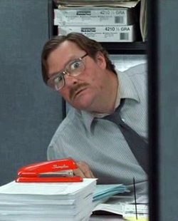
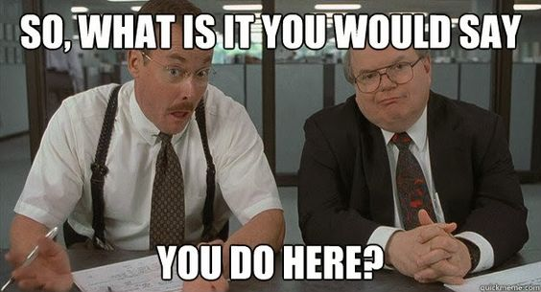
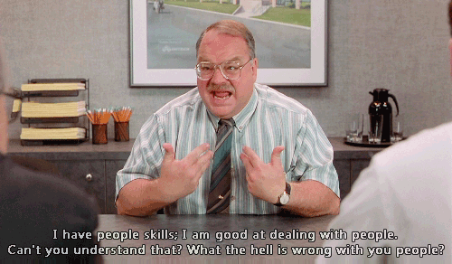
Choose the Best Answer
What is the definition of Service Management?
An organizational unit that gets to be in charge of delivering services
A set of specialized organizational capabilities for providing value in the form of services
A team that takes the specifications from the customer and brings them down to the engineers…because…engineers are not good at dealing with customers

Slide 8
Why ITIL Practitioner?
Source: Images copyright ITSM Academy and /or Axelos unless otherwise noted

Slide 9
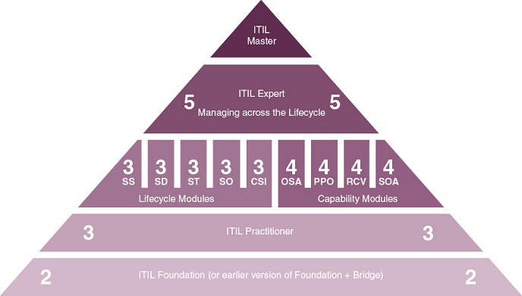
ITIL Practitioner

Slide 10
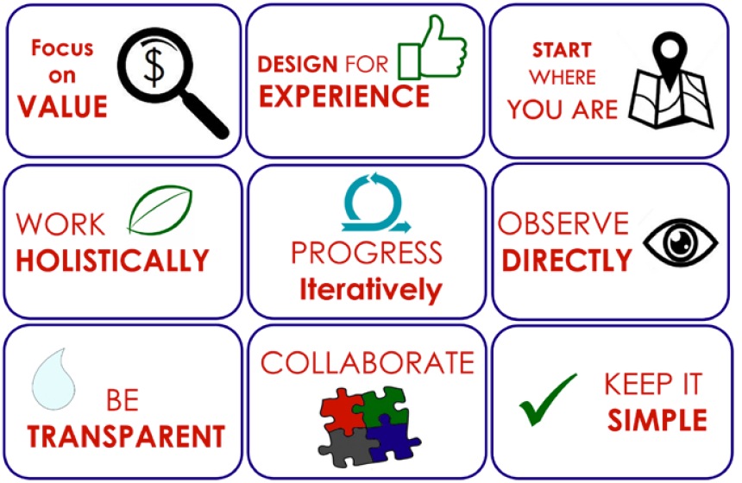
Nine Guiding Principles

Slide 11
Value is determined by the customer, not the service provider
Activities that do not contribute value, either directly or indirectly, should be scrutinized for necessity and removed if possible
Prioritizing work and improvement opportunities should be done based on which ones add the most value for the customer

Slide 12
Focus should be not only on value, but also on the experience of the customers and users
Perceptions of value outside of the actual outcome are based on user experience
There may be multiple touchpoints where the customers/users interact with the service – key interactions =“moments of truth”
Work to eliminate the most negative customer experience touchpoints to improve overall customer satisfaction with the service

Slide 13
Most services and processes have parts that work and add value – recognize the good work and effort that has been done
Starting over from scratch should be the exception not the rule
It is easier to redesign or streamline existing processes then to completely re-engineer the process
Look for opportunities to improve efficiency and remove waste

Slide 14
Work to understand the value chain from an end to end perspective – “systems thinking”
Improve velocity and flow by understanding interfaces and dependencies within and between services and processes
Don’t optimize one process or activity at the expense of the overall service

Slide 15
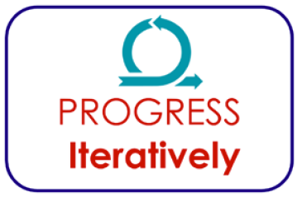
Organize work to make progress in small, manageable increments
Resist the temptation to do everything at once
Focus on smaller improvements is sharper and easier to maintain
Easier to show value sooner and build upon incremental gains – keep the momentum going

Slide 16
Don’t make decisions based on assumptions (or outdated documentation, or misaligned metrics)
Unfounded assumptions can lead to poor decisions that can be disastrous to quality, budgets, and timelines
To know what is really going on, observe and measure it directly
Base decisions on information that is as accurate as can be

Slide 17
Teams should be as aware as possible of what is happening, and why it is happening
The more people are aware of what is going on, the more they will help and the less they will obstruct
Make things as transparent as possible

Slide 18
Best practice frameworks (Agile, DevOps, Lean, ITIL, etc) do not work well at all without appropriate communication and collaboration
Identifying and managing all types of stakeholders is important
The most important stakeholder is THE CUSTOMER – involve them early and often
Having the right people involved in the right ways greatly increases the likelihood of long term success

Slide 19
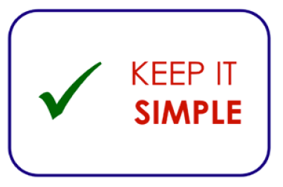
Ask the questions – Does this create value? How does it create value?
If something doesn’t provide value or a useful outcome, eliminate it
For a process or procedure, use the minimum number of steps required to achieve the objective (minimum viable process)
Challenging old assumptions and the status quo is often necessary
Overly complex work methods rarely maximize outcomes or minimize costs

Slide 20
Break-Out Session
Divide into teams
Choose at least two (or more) guiding principles
Discuss how you would combine the guiding principles you chose, and give an example of how you would use them to make an improvement or deliver a more positive outcome
The team that gives the best report-out wins a prize

Slide 21
Q&A

Slide 22
I Train IT Leaders LLC

Slide 23
I Train IT Leaders LLC
Additional Classes:
ITIL Foundation Overview, ITIL Executive Overview, DevOps Overview
DevOps Foundation
Certified Agile Service Manager
Certified Process Design Engineer
Coming later in 2017:
Business Relationship Management Professional
Certified Agile Process Owner
DevOps Leader
ITSMF USA Boise LIG

